Slide 1
ILO HQ Geneva, May 10th 2017
Living conditions among persons with disabilities in low-income contexts
Expert Meeting on Monitoring and Evaluation for Disability-inclusive Development
Arne H Eide
Chief Scientist
SINTEF Technology and Society

Slide 2
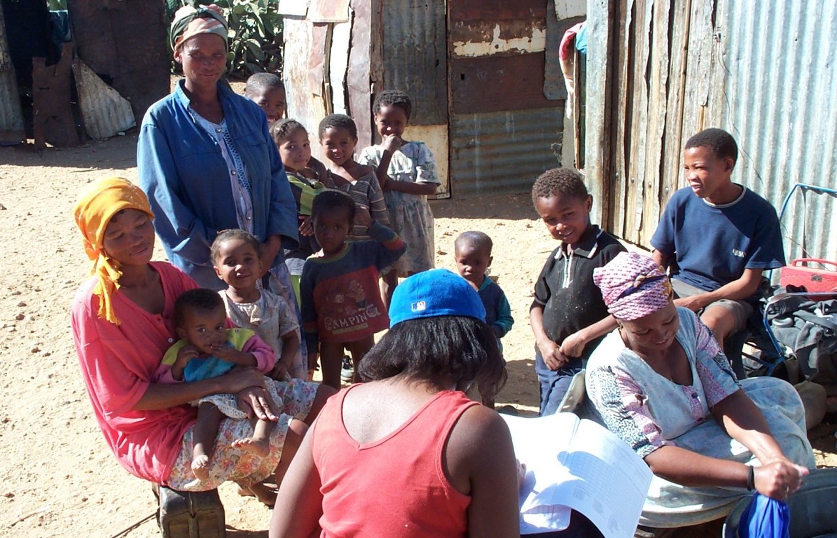
Studies on living conditions among people with disabilities
Namibia (2003)
Zimbabwe (2003/2013)
Malawi (2004/2017)
Zambia (2006/2015)
South Africa (2006)
Mozambique (2009/2018)
Lesotho (2010)
Swaziland (2011)
Botswana (2016)
Nepal (2016)
www.sintef.no
arne.h.eide@sintef.no

Slide 3
LC studies in southern Africa
Participatory approach
Cross-sectional, two-stage cluster sampling:
Selection of EAs based on National Sampling Frame
1st stage data collection: screening procedure covering all households in selected EAs to identify households with disabled members
2nd stage data collection:
full interviews of identified households with disabled members
full interviews of neighbouring households without disabled members
Questionnaires:
Screening instrument (Washington Group + UNICEF/WG Child Module)
Living conditions household level
Disability specific questionnaire including ICF based measures on activity and participation

Slide 4
Overview of the study process
Detailed interview of household with disabled member
Interview of person/s with disabilities
Household listing and screening
Detailed interview of household without disabled member (matched)
Interview of person/s without disabilities (matched)

Slide 5
RELEVANCE FOR SDG MONITORING
Service gaps
hhO
Accessibility of public and private services
Employment
Discrimination
Assistive devices
Education
Health literacy
HOUSEHOLD
LEVEL
Healthy lives
Poverty
Social participation
Abuse
Violence
Socio-economic status
Environmental barriers
Dietary diversity
Food availability
INDIVIDUAL
LEVEL
Dependency ratio
Access to information
Availability of:
Energy
Sanitation
Water
Housing infra- structure

Slide 6
SDG disability specific indicators
Gender disparities: access to all levels of education
Productive employment: Unemployment rate
Empowerment: Voting turnout
Social protection: Percentage receiving benefits
Health coverage:
Percentage receiving needed health care
Percentage receiving needed assistive devices
Violence against women: Percentage of women/girls subjected to physical and/or sexual abuse
Access to water: Percentage using safely managed drinking water
Access to sanitation: Percentage using safely managed sanitation services
Indicators disaggregated by with/without disability

Slide 7
Results from LC studies in southern Africa (2003 – 2016)

Slide 8
Results from LC studies in southern Africa (2003 – 2014)

